Slide 1
Please make a copy!
File -> Make a Copy
Remember to include a text file with each of your SQL queries in your project submission

Slide 2
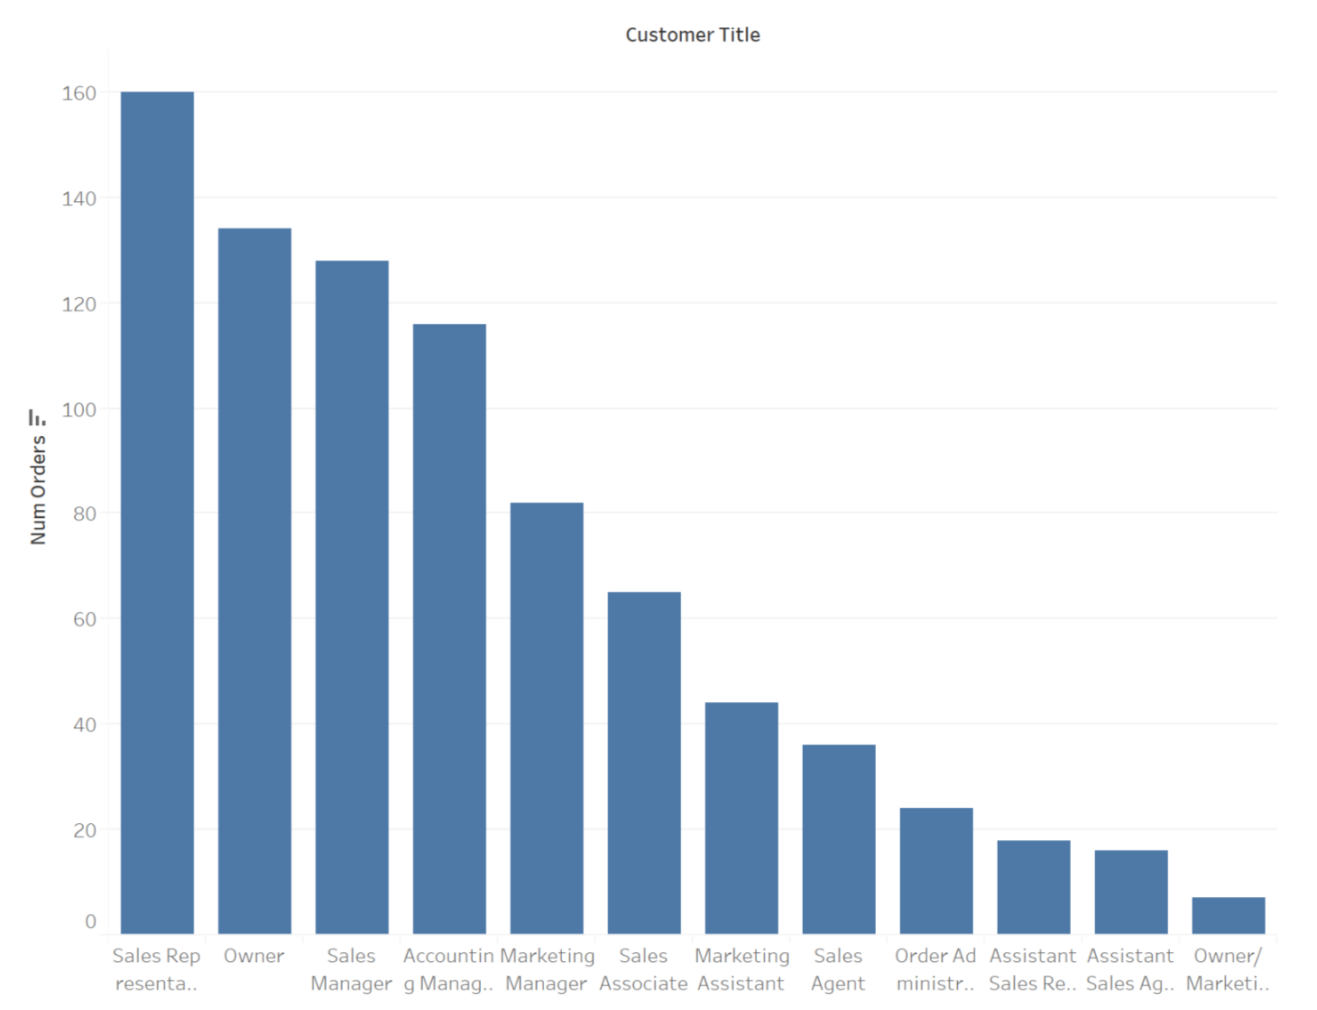
Figure 1
<visualization>
The total number of orders for each type (represented by customer title) of customers
Notes:
SELECT c.ContactTitle customer_title, COUNT(*) num_orders
FROM Customers c
JOIN Orders o
ON o.CustomerID = c.CustomerID
GROUP BY 1
ORDER BY 2 DESC;

Slide 3
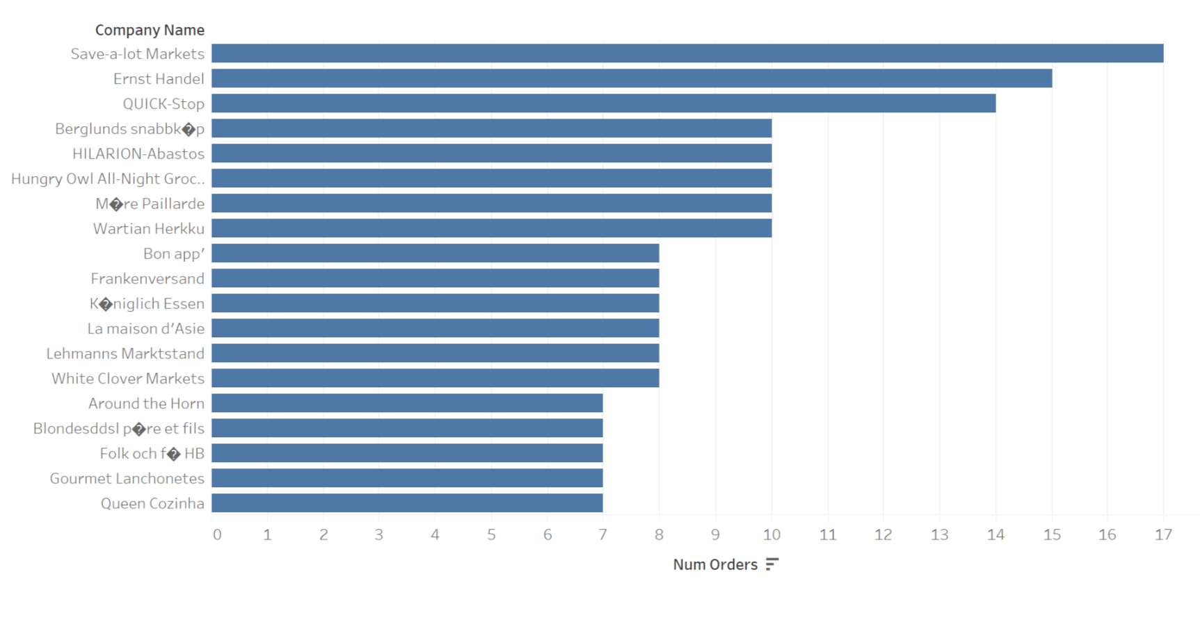
Figure 2
<visualization>
The top customers ordered by total number of orders in 2015 (only those having > 6 orders are shown)
Notes:
SELECT c.CustomerID, c.CompanyName, COUNT(*) num_orders
FROM Customers c
JOIN Orders o
ON o.CustomerID = c.CustomerID
WHERE o.OrderDate BETWEEN '2015-01-01' AND '2015-12-31'
GROUP BY 1, 2
HAVING COUNT(*) > 6
ORDER BY 3 DESC;

Slide 4
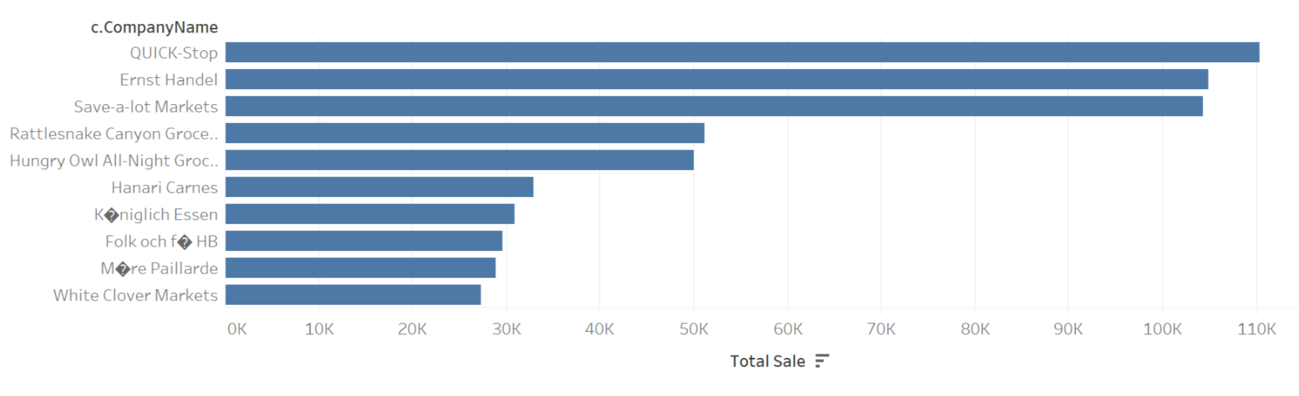
Figure 3
<visualization>
The top 10 customers with largest total sales in all years
Notes:
WITH t1 as (
SELECT o.OrderId, d.UnitPrice*d.Quantity*(1-d.Discount) order_sale
FROM Orders o
JOIN Orderdetails d
ON d.OrderID = o.OrderId)
SELECT c.CustomerID, c.CompanyName, SUM(t1.order_sale) total_sale
FROM Customers c
JOIN Orders o
ON o.CustomerID = c.CustomerID
JOIN t1
ON t1.OrderId = o.OrderId
GROUP BY 1, 2
ORDER BY 3 DESC
LIMIT 10;

Slide 5
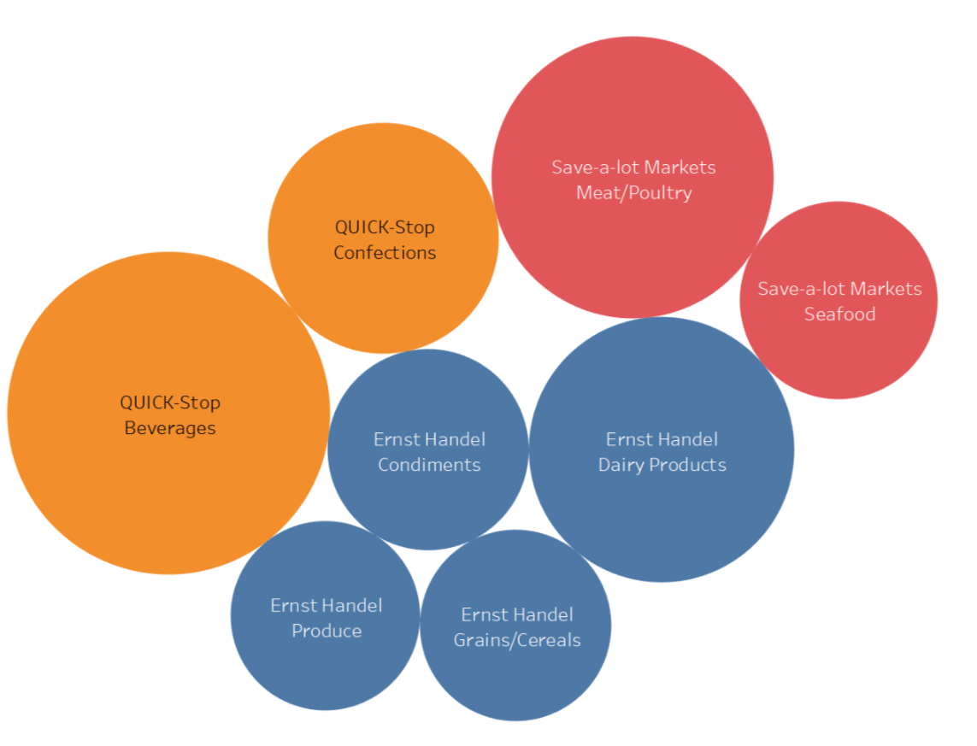
Figure 4
<visualization>
The highest total sale by companies in categories of products are occupied by three companies. Each circle represents one category, sizes represent total sales.
Notes:
WITH t1 as (
SELECT o.OrderId, d.ProductID, d.UnitPrice*d.Quantity*(1-d.Discount) order_sale
FROM Orders o
JOIN Orderdetails d
ON d.OrderID = o.OrderId),
t2 as (
SELECT c.CustomerID, c.CompanyName, a.CategoryID, a.CategoryName, SUM(t1.order_sale) total_sale
FROM Customers c
JOIN Orders o
ON o.CustomerID = c.CustomerID
JOIN t1
ON t1.OrderId = o.OrderId
JOIN Products p
ON p.ProductID = t1.ProductID
JOIN Categories a
ON a.CategoryID = p.CategoryID
GROUP BY 1, 2, 3, 4),
t3 as (
SELECT CategoryID, CategoryName, MAX(total_sale) max_total_sale
FROM t2
GROUP BY 1, 2)
SELECT t2.CompanyName, t2.CategoryName, t3.max_total_sale
FROM t2
JOIN t3
ON t2.CategoryID = t3.CategoryID and t2.CategoryName = t3.CategoryName
WHERE t2.total_sale = t3.max_total_sale;

